Slide 1
Understanding python

Slide 2
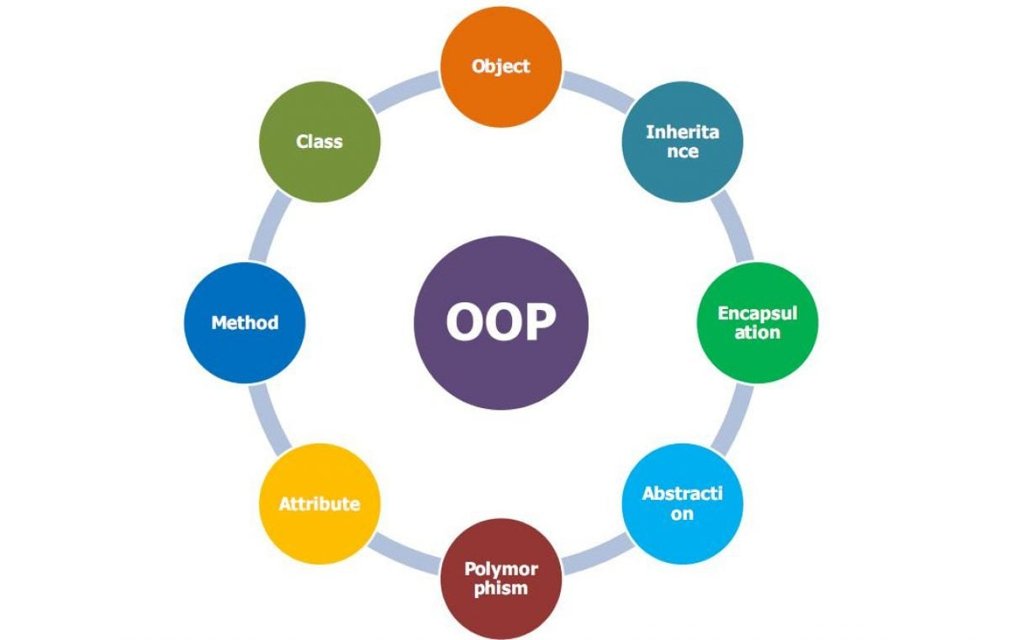
Object oriented programming
OOP is a type of programming which revolves around the concept object having some attributes and behaviors.
Basic OOPs concepts:
Classes
Abstraction
Encapsulation
Polymorphism
Inheritance

Slide 3
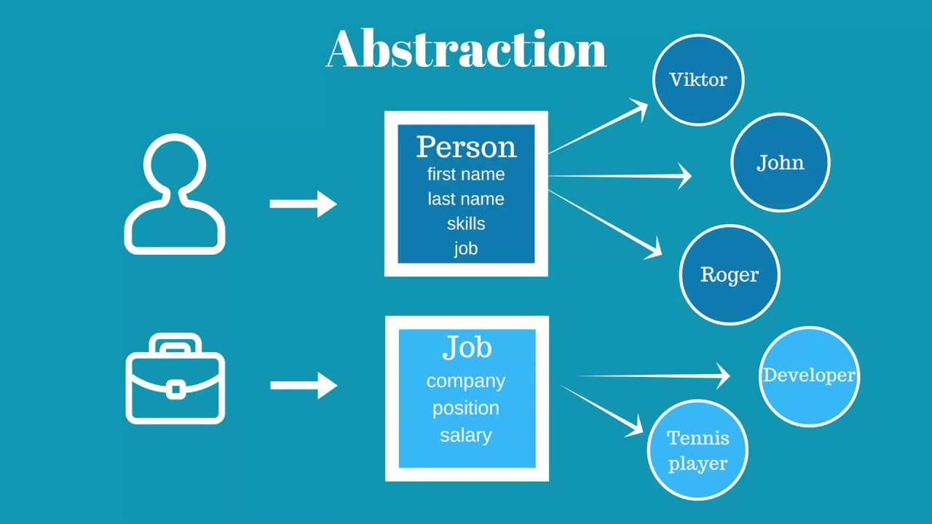
Abstraction
The process of showing the essential details while hiding the unnecessary information reducing the programming complexity.

Slide 4
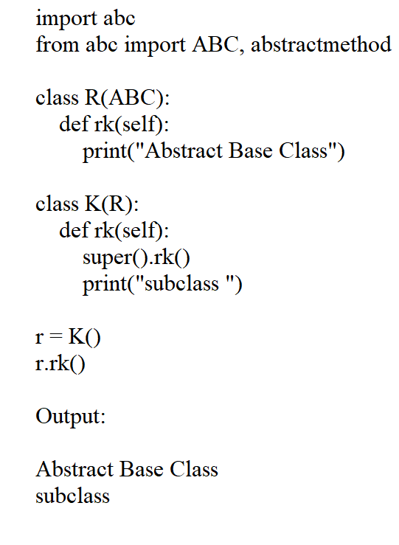
Python example

Slide 5
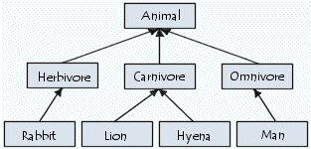
Inheritance
It is a mechanism where you can derive a class from another class for a hierarchy of classes that share a set of attributes and methods.

Slide 6
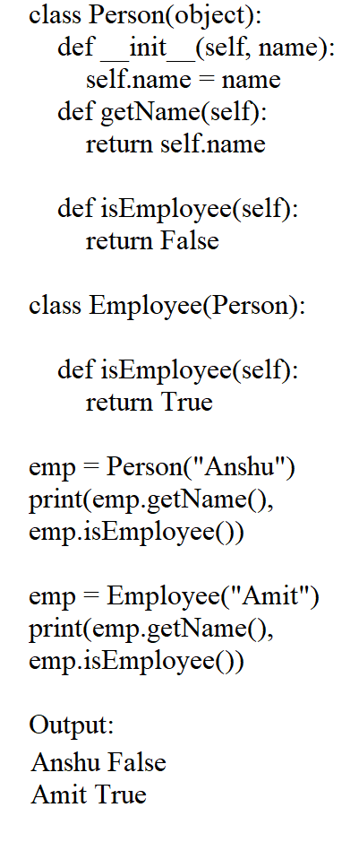
Python example

Slide 7
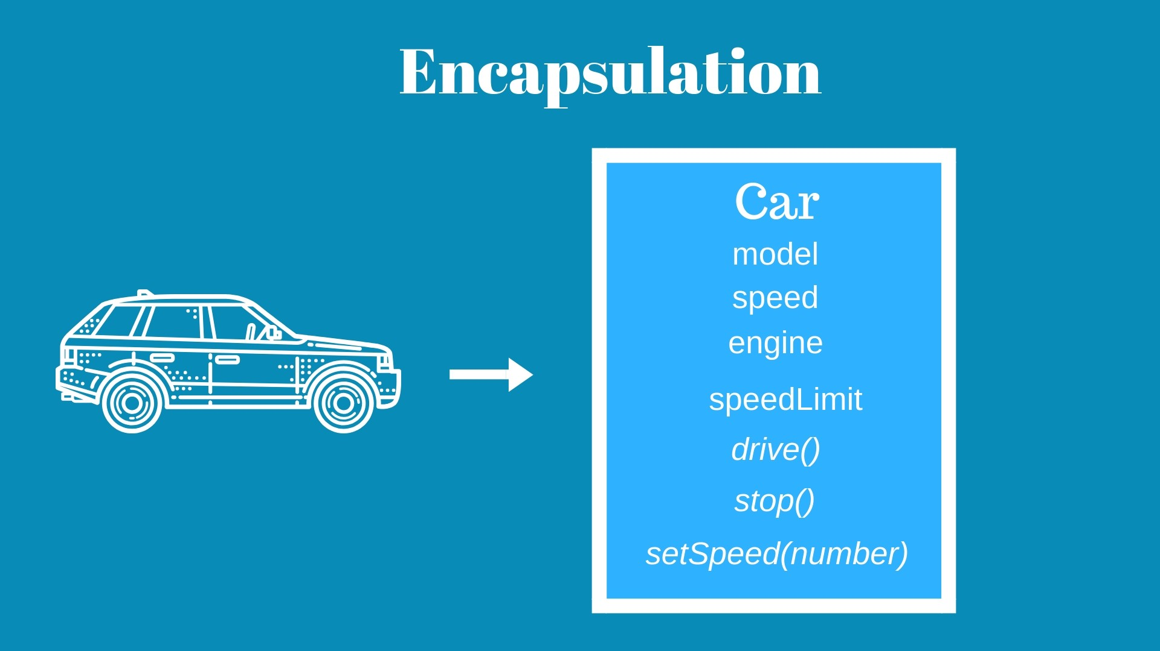
Encapsulation
It describes the idea of bundling data and methods that work on that data within one unit, e.g., a class in Java.

Slide 8
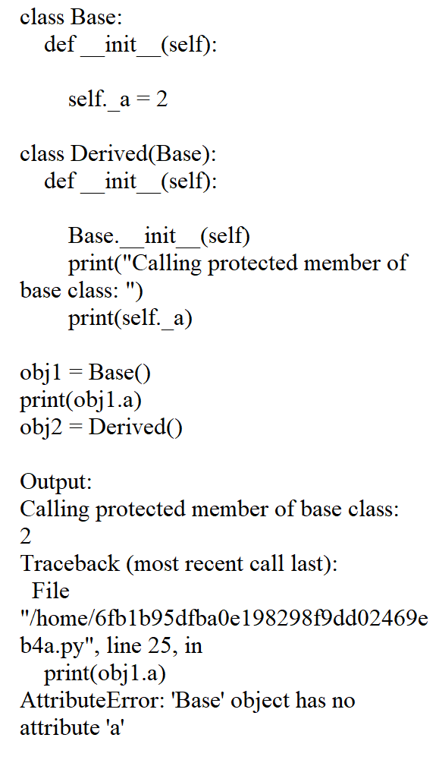
Python Example

Slide 9
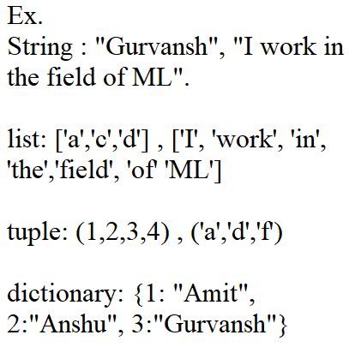
Structural data types in python
String: A string value is a collection of one or more characters put in single, double or triple quotes.
List : A list object is an ordered collection of one or more data items, not necessarily of the same type, put in square brackets.
Tuple: A Tuple object is an ordered collection of one or more data items, not necessarily of the same type, put in parentheses.
A dictionary object is an unordered collection of data in a key : value pair form, enclosed in curly brackets.

Slide 10
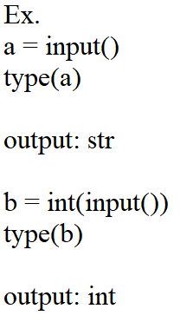
Input in Python
To take input from the user we use: ‘input()’ function.
The input() function has a limitation to take all the inputs as string type, therefore it is used with implementation of other function to convert the data type of the input.

Slide 11
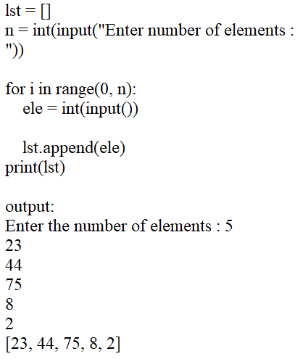
Working with list in python(input)
To take input in the list the input() function is used with conjunction with looping statements and the following functions:
Append()
Map()
Split()

Slide 12
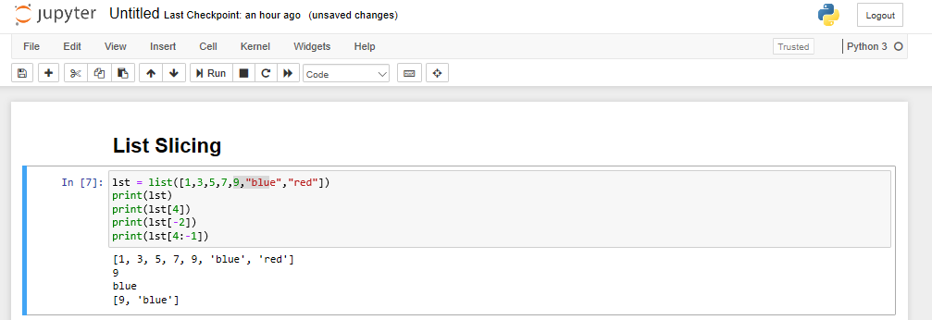
List (slicing)
Slicing in a list done with the help of index number.
The index number in python can be read in two ways i.e. positive(start – end) or negative(end – start) and are written in the [] brackets after the name of the list variable.

Slide 13
Thank you

